Slide 1
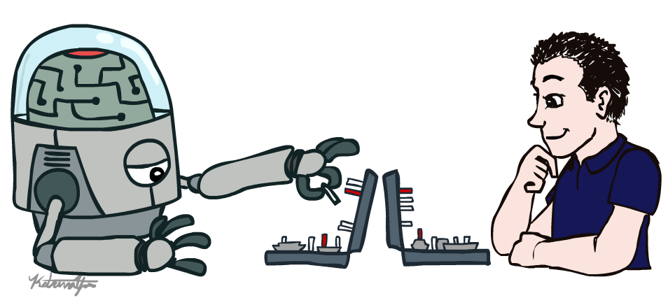
Fundamentals of Artificial Intelligence
Introduction
Instructor: Dr. Hatim Alsuwat
Umm Al-Qura University

Slide 2
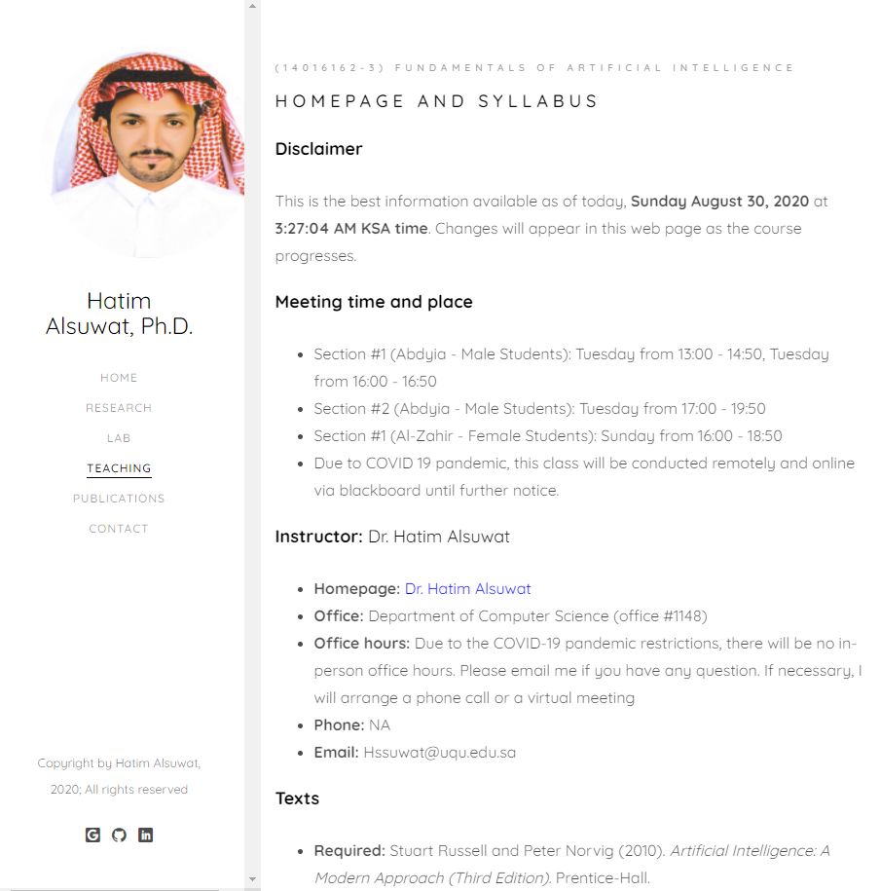
Course Information
https://hatimalsuwat.github.io/AI.html
Communication:
Announcements on webpage/ emails/ blackboard
Questions? Email me.
Staff email: hssuwat@uqu.edu.sa
Course technology:
Website
UQU Blackboard
Autograded projects.
interactive homework
Regular homework
Help us make it awesome!

Slide 3
Course Information
Course Website https://hatimalsuwat.github.io/AI.html
Discussion:
Please ask any question during the lecture (don’t be shy)
There is no such thing as a stupid question.
Answer others’ questions - if you know the answer ;-)
Learn from others’ questions and answers

Slide 4
Course Information
Prerequisites:
Required: Data Structures and Algorithms
There will be a lot of math and programming
background in data structures and algorithms, linear algebra, and
probability will all be helpful.
You should be prepared to review basic probability on your own if it is
not fresh in your head.

Slide 5
Course Information
Assignments:
Quizzes: there will be several quizzes randomly given
Homework assignments: there will be several homework assignments during the semester.
Group Project: 5 programming projects: Python, groups of 1 or 2
(Programming Language: Course programming projects will be in Python.)
Research project: Develop a Research Question, Find Sources: Reading and Note Taking, Evaluate Sources, Establish a Working Bibliography, Prepare to Write: Consider Audience and Purpose, Put It All Together.
Exams: One Midterm Exam and One Final Exam. Closed book tests will cover the course material.
Assignments are always due on the announced day and time. There will be a late submission penalty of 20%/day after the due date for homework and project assignments unless it is approved by the instructor. Cutoff date for assignments is 5 days after due date! Exams must be taken as scheduled except in cases of extenuating circumstances such as a documented emergency.
Participation can help on margins

Slide 6
Course Information
Grading:
Midterm Exam: 20%
Projects:10%
Homework Assignments: 10%
Research project: 15%
Quizzes: 5%
Final Exam: 40%
Total score that can be achieved: 100

Slide 7
Course Information
Meeting time and place:
Office: Department of Computer Science (office #1148)
Office hours: Due to the COVID-19 pandemic restrictions, there will be no in-person office hours. Please email me if you have any question. If necessary, I will arrange a phone call or a virtual meeting
Email: Hssuwat@uqu.edu.sa

Slide 8

Textbook
Not required, but for students who want to read more we recommend
Russell & Norvig, AI: A Modern Approach, 3rd Ed.
Warning: Not a course textbook, so our presentation does not necessarily follow the presentation in the book.

Slide 9
Acknowledgements
Dan Klein
Pieter Abbeel
Stuart Russell
Brad Miller
Nick Hay
John DeNero
Pooyan Fazli

Slide 10
Course Information: Feedback
Please give feedback positive or negative as early as you can via email.

Slide 11
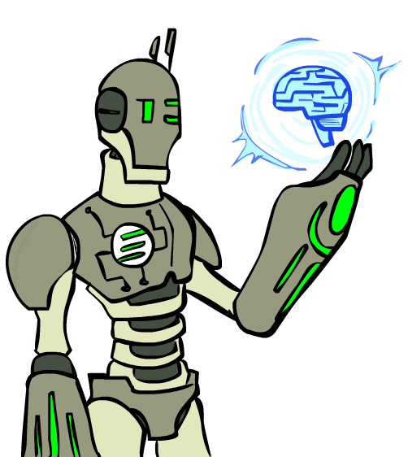
Today
What is artificial intelligence?
What can AI do?
What is this course?

Slide 12
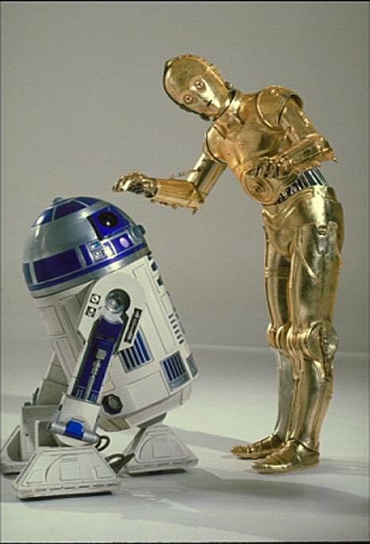
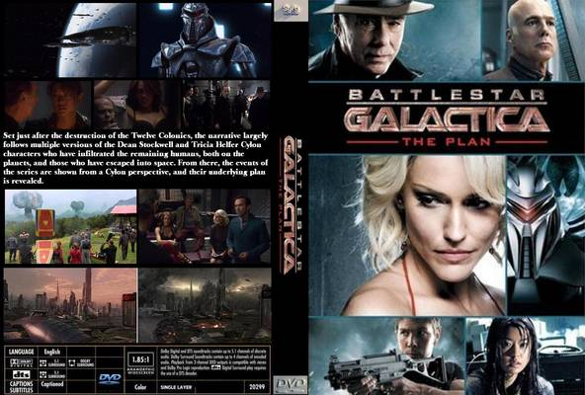
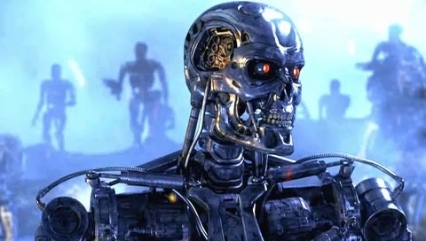
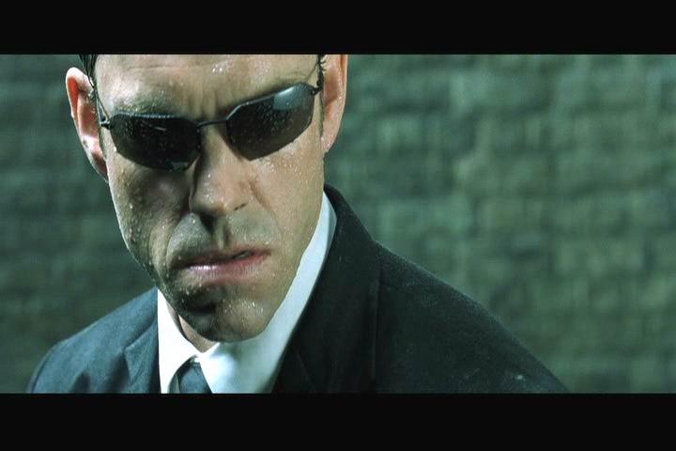
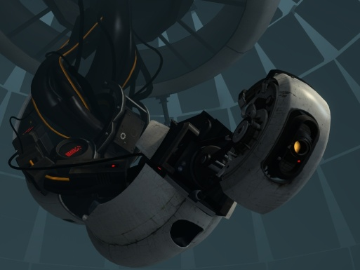
Sci-Fi AI?

Slide 13
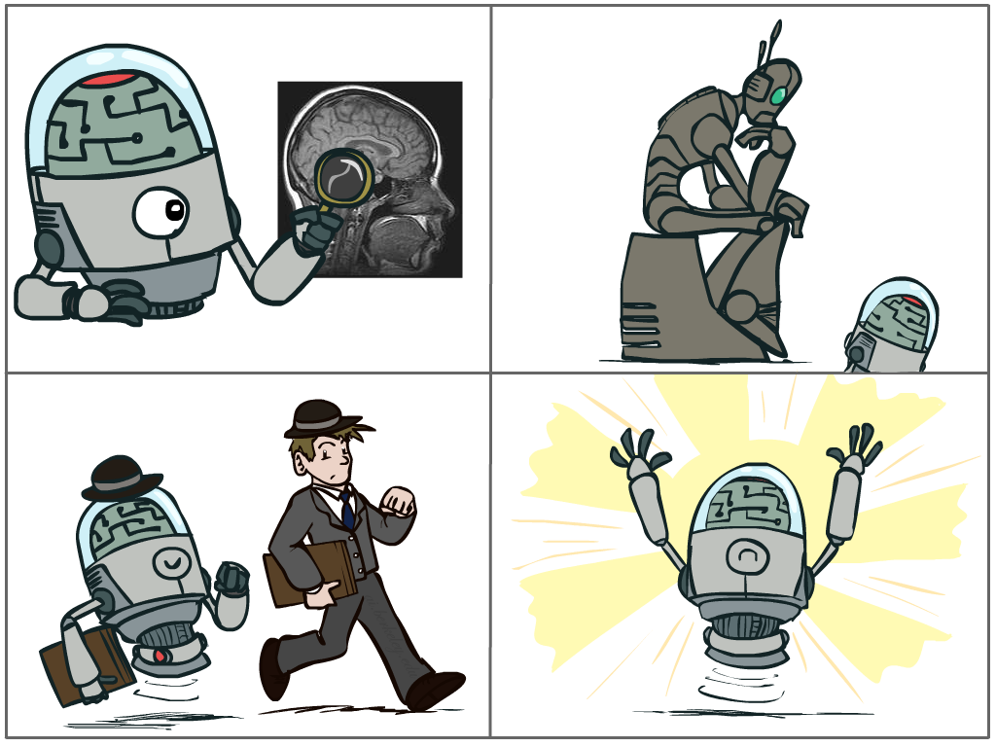
What is AI?
The science of making machines that:
Think like people
Think rationally
Act like people
Act rationally

Slide 14
Rational Decisions
We’ll use the term rational in a very specific, technical way:
Rational: maximally achieving pre-defined goals
Rationality only concerns what decisions are made
(not the thought process behind them)
Goals are expressed in terms of the utility of outcomes
Being rational means maximizing your expected utility
A better title for this course would be:
Computational Rationality

Slide 15
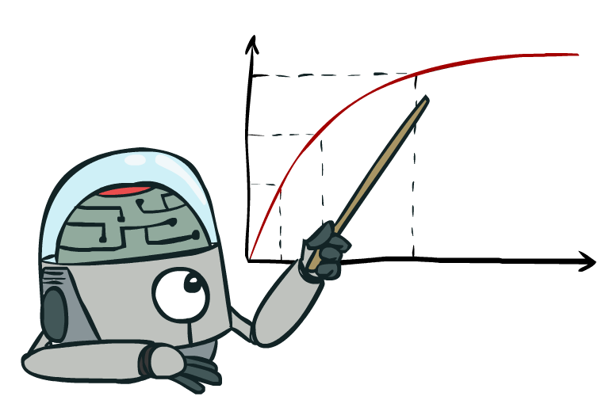
Maximize Your
Expected Utility

Slide 16
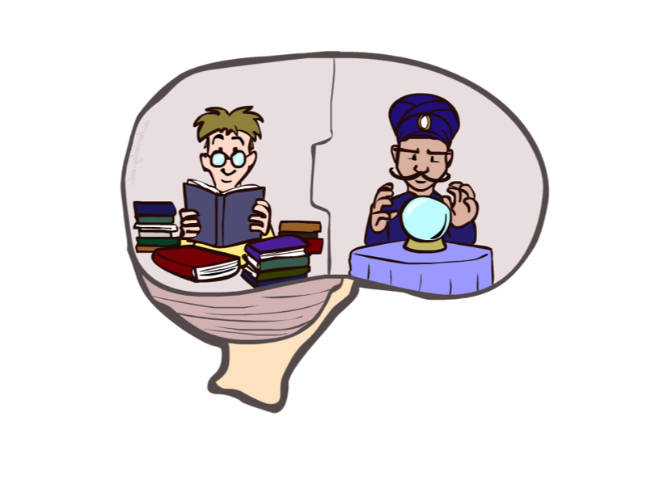
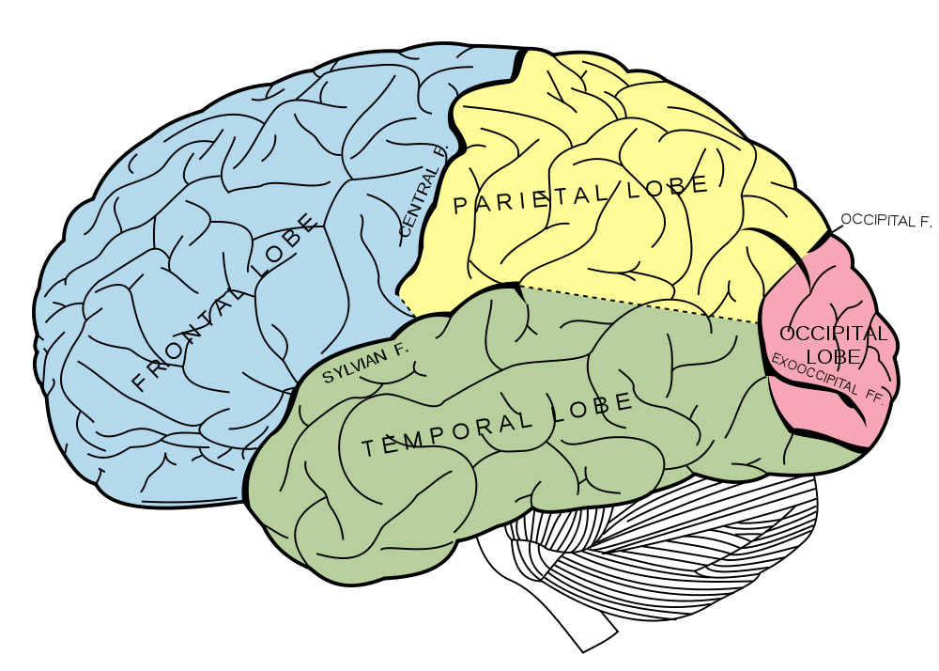
What About the Brain?
Brains (human minds) are very good at making rational decisions, but not perfect
Brains aren’t as modular as software, so hard to reverse engineer!
“Brains are to intelligence as wings are to flight”
Lessons learned from the brain: memory and simulation are key to decision making

Slide 17
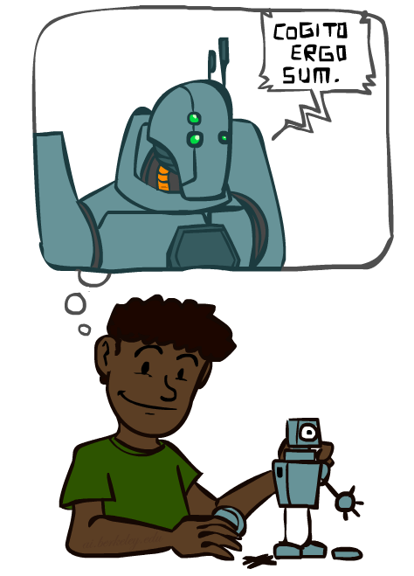
A (Short) History of AI
Demo: HISTORY – MT1950.wmv

Slide 18


Slide 19
A (Short) History of AI
1940-1950: Early days
1943: McCulloch & Pitts: Boolean circuit model of brain
1950: Turing's “Computing Machinery and Intelligence”
1950—70: Excitement: Look, Ma, no hands!
1950s: Early AI programs, including Samuel's checkers program, Newell & Simon's Logic Theorist, Gelernter's Geometry Engine
1956: Dartmouth meeting: “Artificial Intelligence” adopted
1965: Robinson's complete algorithm for logical reasoning
1970—90: Knowledge-based approaches
1969—79: Early development of knowledge-based systems
1980—88: Expert systems industry booms
1988—93: Expert systems industry busts: “AI Winter”
1990—: Statistical approaches
Resurgence of probability, focus on uncertainty
General increase in technical depth
Agents and learning systems… “AI Spring”?
2000—: Where are we now?

Slide 20
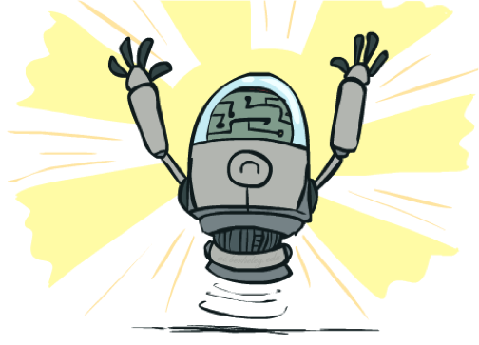
What Can AI Do?
Quiz: Which of the following can be done at present?
Play a decent game of table tennis?
Play a decent game of Jeopardy?
Drive safely along a curving mountain road?
Drive safely along Telegraph Avenue?
Buy a week's worth of groceries on the web?
Buy a week's worth of groceries at bin Dawood?
Discover and prove a new mathematical theorem?
Converse successfully with another person for an hour?
Perform a surgical operation?
Put away the dishes and fold the laundry?
Translate spoken Chinese into spoken English in real time?
Write an intentionally funny story?

Slide 21
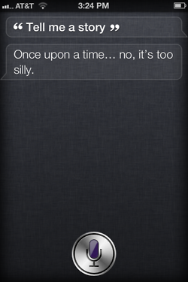
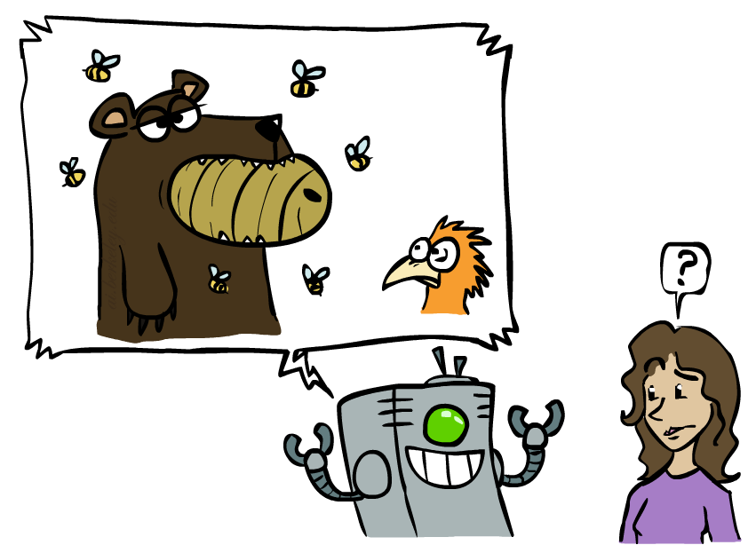
Unintentionally Funny Stories
One day Joe Bear was hungry. He asked his friend
Irving Bird where some honey was. Irving told him
there was a beehive in the oak tree. Joe walked to
the oak tree. He ate the beehive. The End.
Henry Squirrel was thirsty. He walked over to the
river bank where his good friend Bill Bird was sitting.
Henry slipped and fell in the river. Gravity drowned.
The End.
Once upon a time there was a dishonest fox and a vain crow. One day the crow was sitting in his tree, holding a piece of cheese in his mouth. He noticed that he was holding the piece of cheese. He became hungry, and swallowed the cheese. The fox walked over to the crow. The End.
[Shank, Tale-Spin System, 1984]

Slide 22
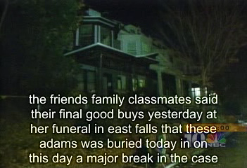
Natural Language
Speech technologies (e.g. Siri)
Automatic speech recognition (ASR)
Text-to-speech synthesis (TTS)
Dialog systems
Demo: NLP – ASR tvsample.avi

Slide 23
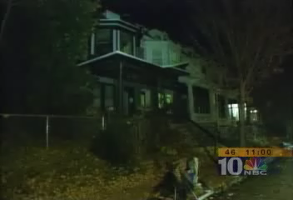

Slide 24
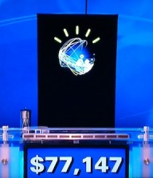
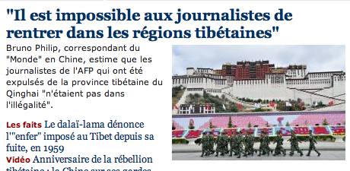
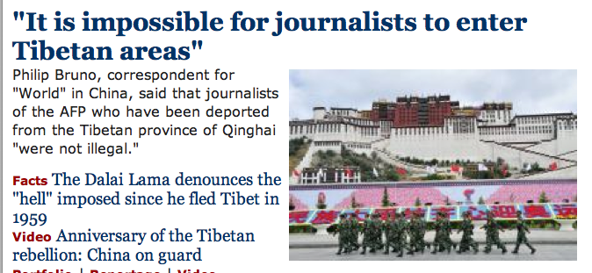
Natural Language
Speech technologies (e.g. Siri)
Automatic speech recognition (ASR)
Text-to-speech synthesis (TTS)
Dialog systems
Language processing technologies
Question answering
Machine translation
Web search
Text classification, spam filtering, etc…

Slide 25
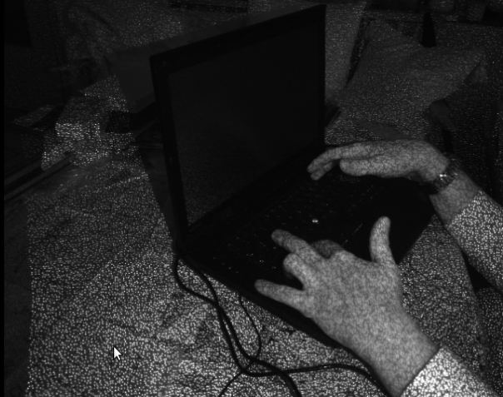
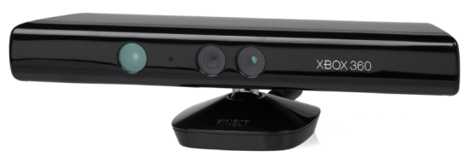
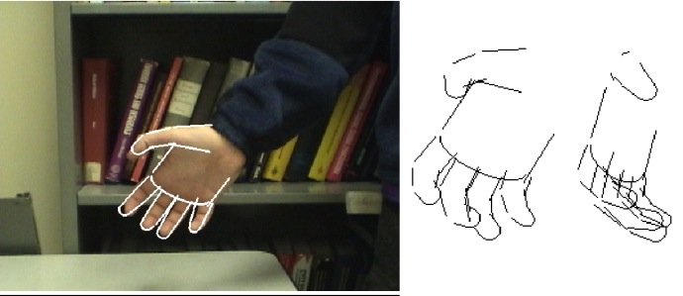
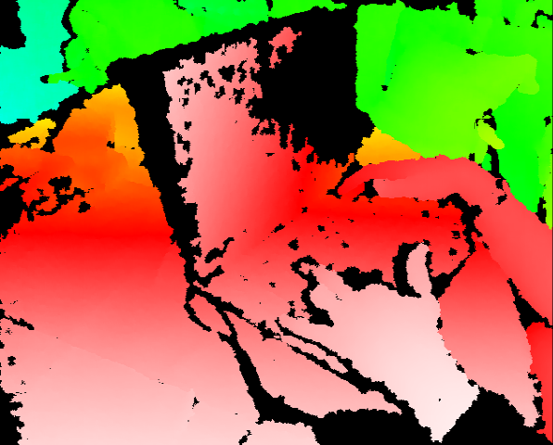
Vision (Perception)
Object and face recognition
Scene segmentation
Image classification
Demo1: VISION – lec_1_t2_video.flv
Images from Erik Sudderth (left), wikipedia (right)
Demo2: VISION – lec_1_obj_rec_0.mpg

Slide 28
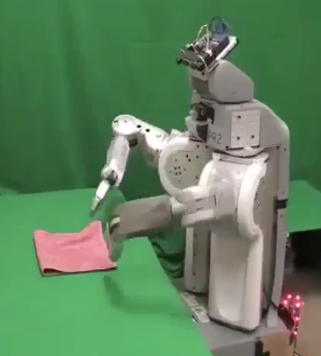
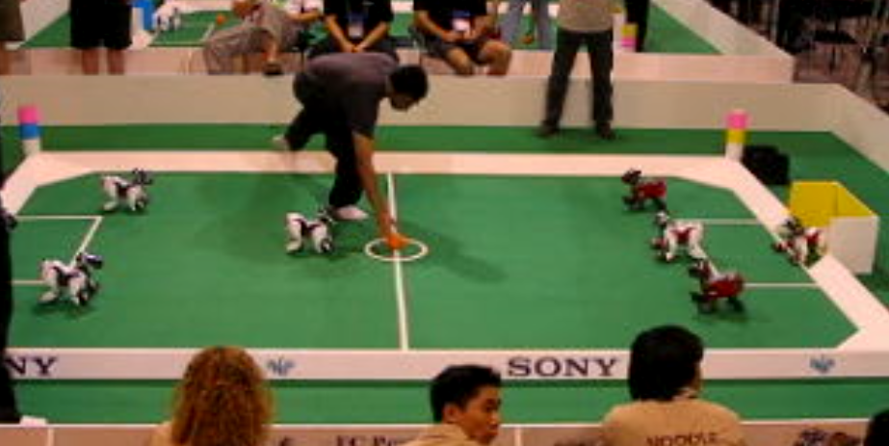
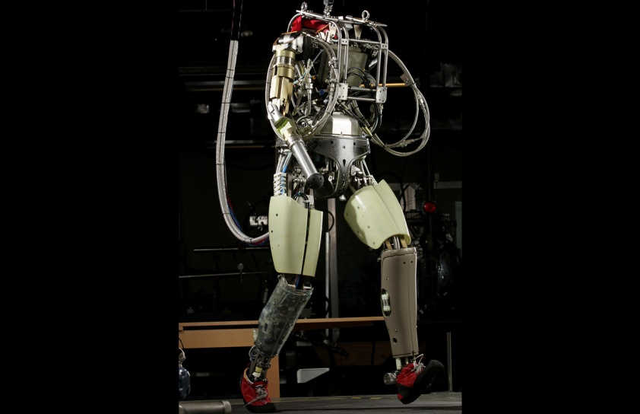
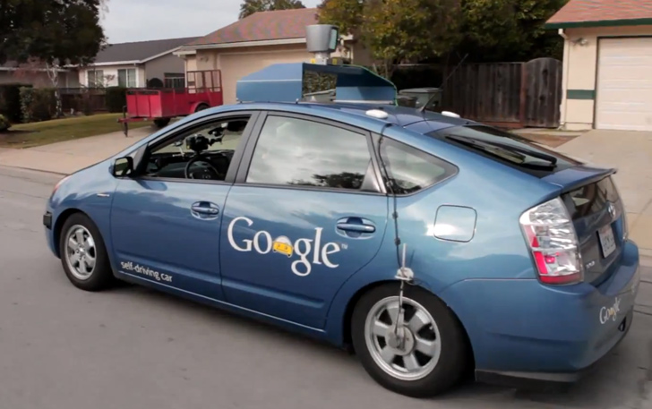
Robotics
Demo 1: ROBOTICS – soccer.avi
Demo 4: ROBOTICS – laundry.avi
Demo 2: ROBOTICS – soccer2.avi
Demo 5: ROBOTICS – petman.avi
Demo 3: ROBOTICS – gcar.avi
Robotics
Part mech. eng.
Part AI
Reality much
harder than
simulations!
Technologies
Vehicles
Rescue
Soccer!
Lots of automation…
In this class:
We ignore mechanical aspects
Methods for planning
Methods for control
Images from UC Berkeley, Boston Dynamics, RoboCup, Google

Slide 34
Logic
Logical systems
Theorem provers
NASA fault diagnosis
Question answering
Methods:
Deduction systems
Constraint satisfaction
Satisfiability solvers (huge advances!)
Image from Bart Selman

Slide 35
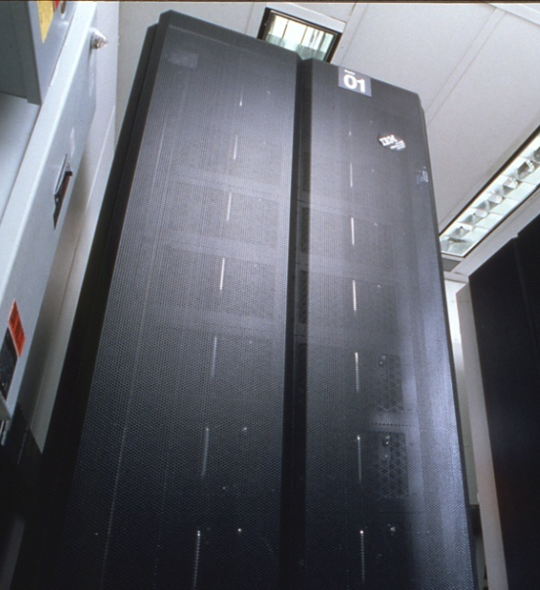
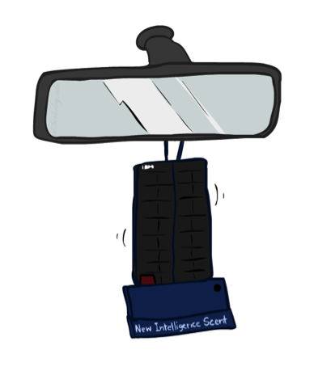
Game Playing
Classic Moment: May, '97: Deep Blue vs. Kasparov
First match won against world champion
“Intelligent creative” play
200 million board positions per second
Humans understood 99.9 of Deep Blue's moves
Can do about the same now with a PC cluster
Open question:
How does human cognition deal with the
search space explosion of chess?
Or: how can humans compete with computers at all??
1996: Kasparov Beats Deep Blue
“I could feel --- I could smell --- a new kind of intelligence across the table.”
1997: Deep Blue Beats Kasparov
“Deep Blue hasn't proven anything.”
Huge game-playing advances recently, e.g. in Go!
Text from Bart Selman, image from IBM’s Deep Blue pages

Slide 36

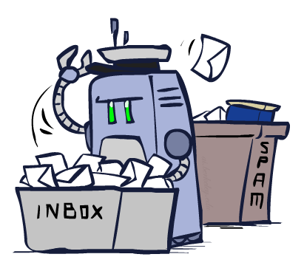
Decision Making
Applied AI involves many kinds of automation
Scheduling, e.g. airline routing, military
Route planning, e.g. Google maps
Medical diagnosis
Web search engines
Spam classifiers
Automated help desks
Fraud detection
Product recommendations
… Lots more!

Slide 37
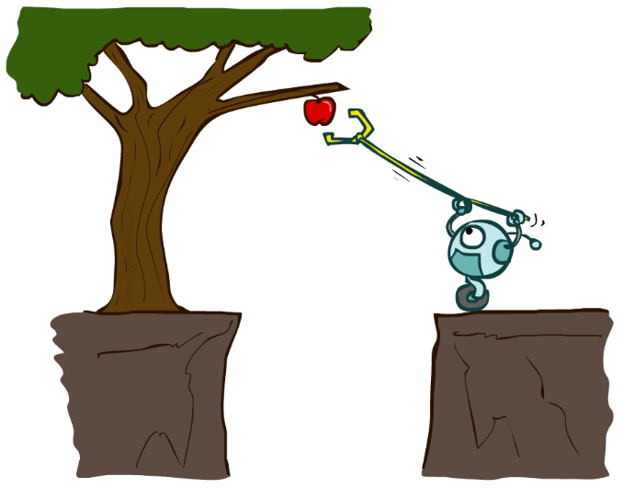
Designing Rational Agents
An agent is an entity that perceives and acts.
A rational agent selects actions that maximize its (expected) utility.
Characteristics of the percepts, environment, and action space dictate techniques for selecting rational actions
This course is about:
General AI techniques for a variety of problem types
Learning to recognize when and how a new problem can be solved with an existing technique
Sensors
Agent
Percepts
Environment
?
Actuators
Actions

Slide 38
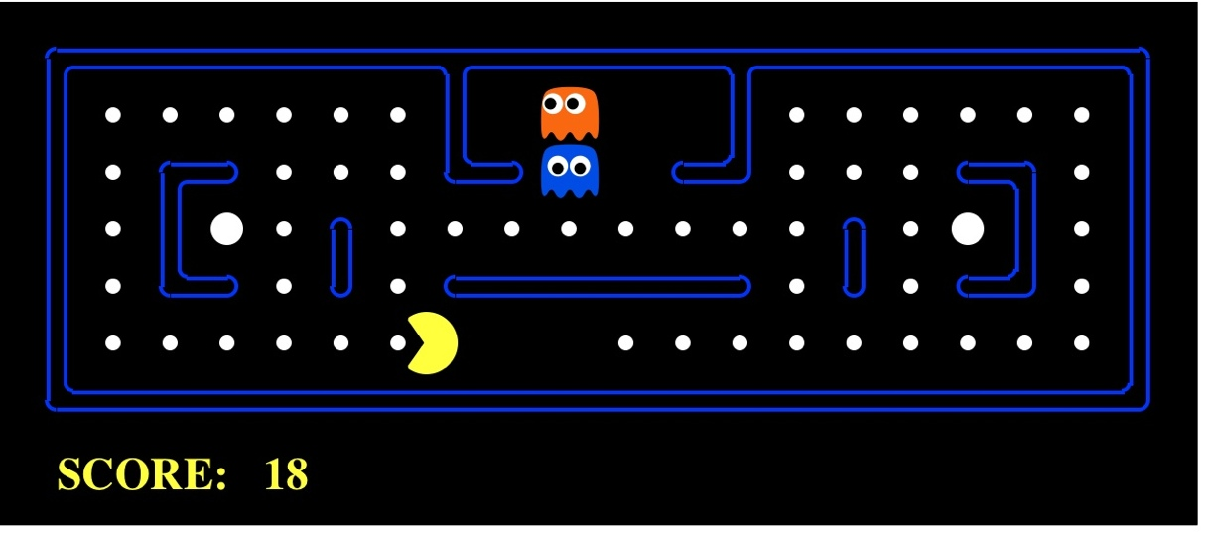
Pac-Man as an Agent
Agent
Environment
Sensors
Percepts
?
Actuators
Actions
Pac-Man is a registered trademark of Namco-Bandai Games, used here for educational purposes
Demo1: pacman-l1.mp4 or L1D2

Slide 39
Course Topics
Part I: Making Decisions
Fast search / planning
Constraint satisfaction
Adversarial and uncertain search
Part II: Reasoning under Uncertainty
Bayes’ nets
Decision theory
Machine learning
Throughout: Applications
Natural language, vision, robotics, games, …

